Slide 1


Slide 2
PRESENTATION ON PLACEMENT MANAGEMENT SYSTEM PRESENTED BY-: POOJA YADAV BATCH EON-: 2021-5759

Slide 3
ABSTRACT
The main objective of Placement Management System is to develop software which manages placement activities in college makes a interactive GUI where TPO can manage details of all students on his console, he can send a mails to students informing about placement activities. Although such a project has a very wide scope, this project contains the most important part i.e. displaying the personal and academic information of a student and company. The students and companies are also provided with the facility of editing some fields like username and password. The project also allows a Data Base Administrator to enter the information of a student and company which is then stored in the corresponding tables in the main database .He can also delete the student and company information after placement is over from the main database. This project is aimed at developing an online application for the Training and Placement Dept. of the college. The system is an online application that can be accessed throughout the organization and outside as well with proper login provided.

Slide 4
PROJECT INTRODUCTION
The project titled “Placement Management System” is software system allows the students to create their profile and upload all the details including their marks on the system.
PMS which helps out the HR Personal in the recruitment of new candidates to the company and helps the recruitment process as a whole.
A college Placement Management System that consists of a student login, company login and an admin login.
PMS handles students as well as company data and efficiently display all this data to respective side.

Slide 5
SYSTEM REQUIREMENTS
HARDWARE REQUIREMENTS:-
I3 processor based computer
4 GB-RAM
Monitor
SOFTWARE REQUIREMENTS:-
Front end: HTML, CSS, JavaScript, Spring boot
Back end: MySQL workbench 8.0.CE
Middleware/server: Apache Tomcat v.8.5
IDE: Spring boot
Browser: Google chrome
Window 10 operating system

Slide 6
MODULE DESIGN
Home Page
Admin Portal
Recruiter Portal
Student Portal

Slide 7
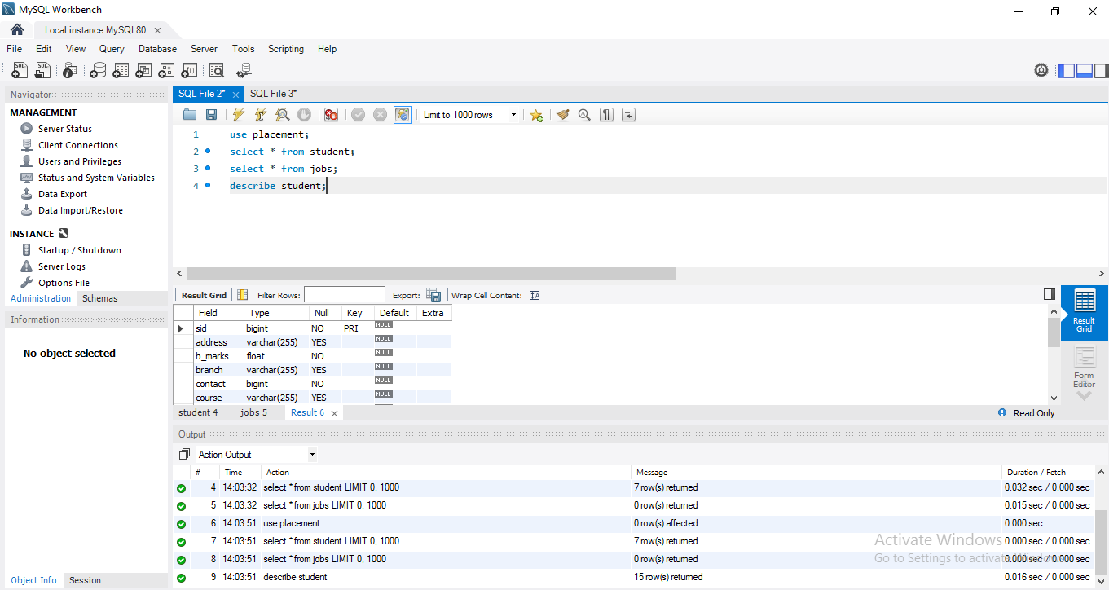
STUDENT DATABASE

Slide 8
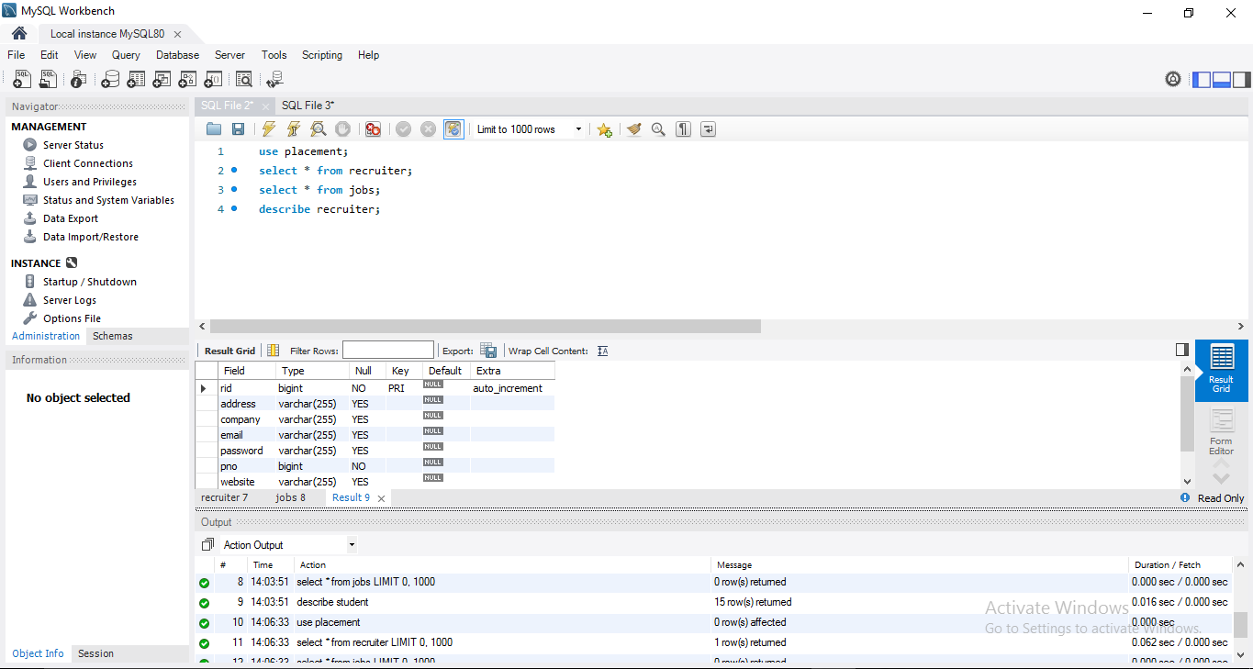
RECRUITER DATABASE

Slide 9
ADMIN DATABASE
User friendly,
Time saving,
Easy to shop with more verities and updated products,
Buy products from anywhere and anytime.

Slide 10
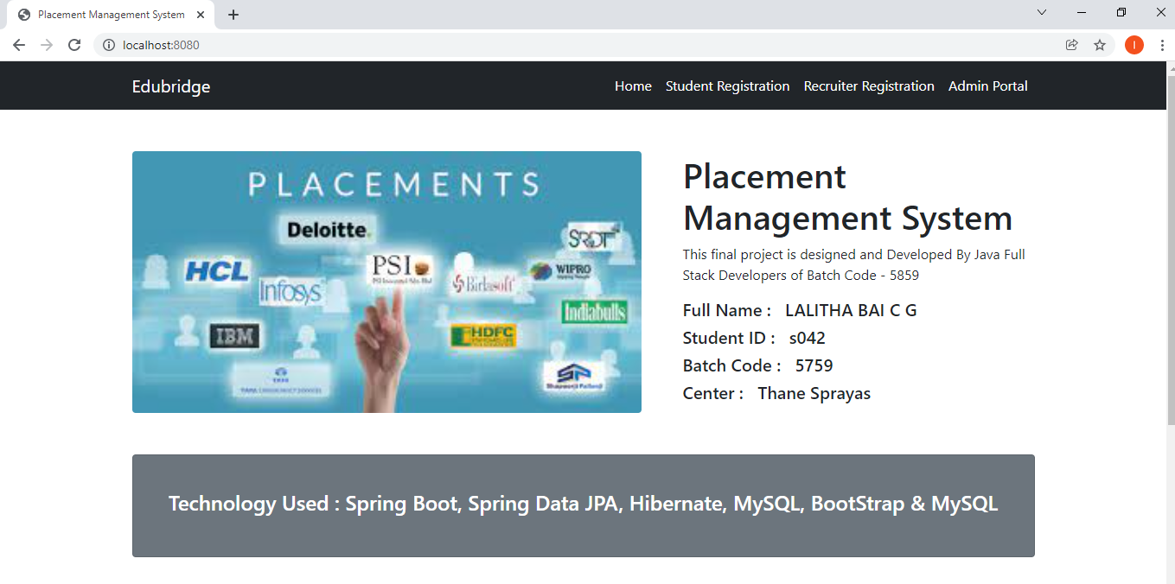
HOME PAGE

Slide 11
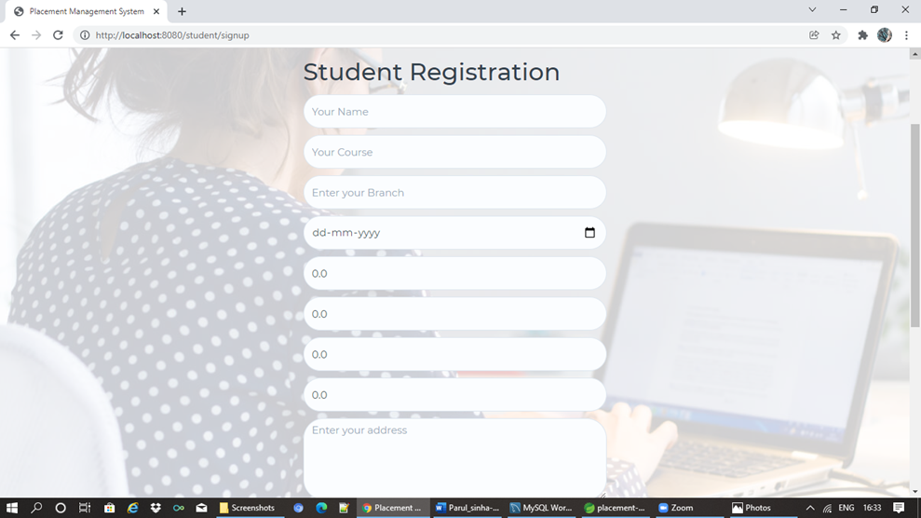
STUDENT REGISTRATION

Slide 12
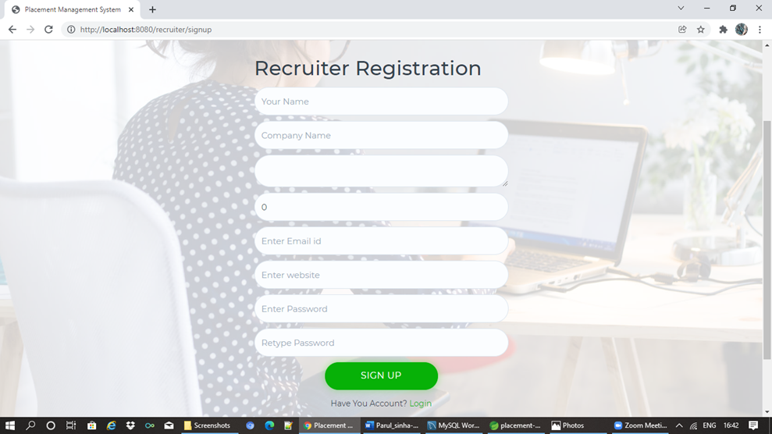
RECRUITER REGISTRATION

Slide 13
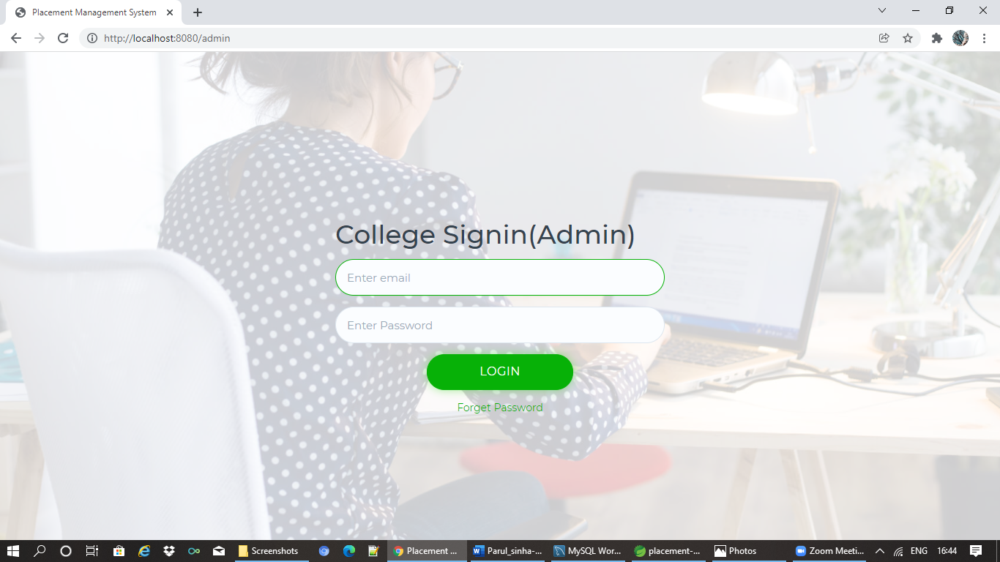
ADMIN REGISTRATION

Slide 14
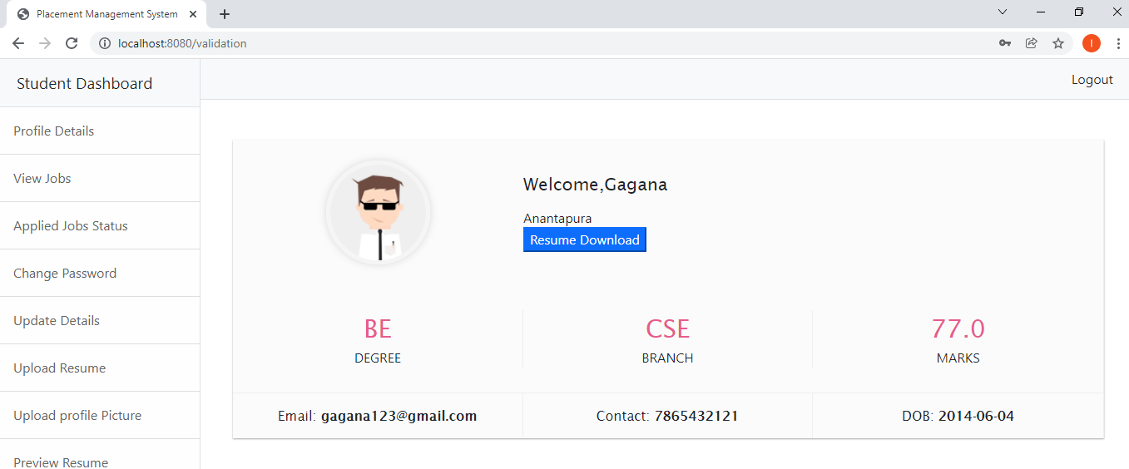
STUDENT DASHBOARD PAGE

Slide 15
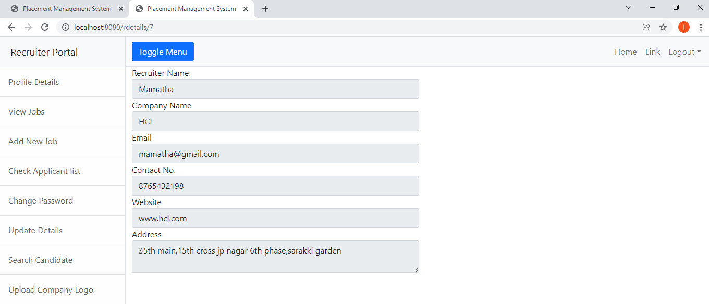
RECRUITER DASHBOARD PAGE

Slide 16
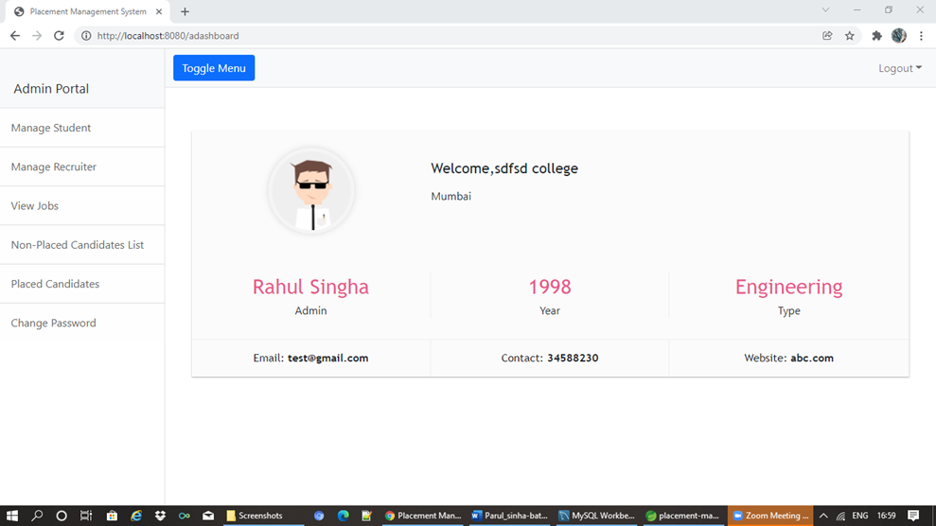
ADMIN DASHBOARD PAGE

Slide 17
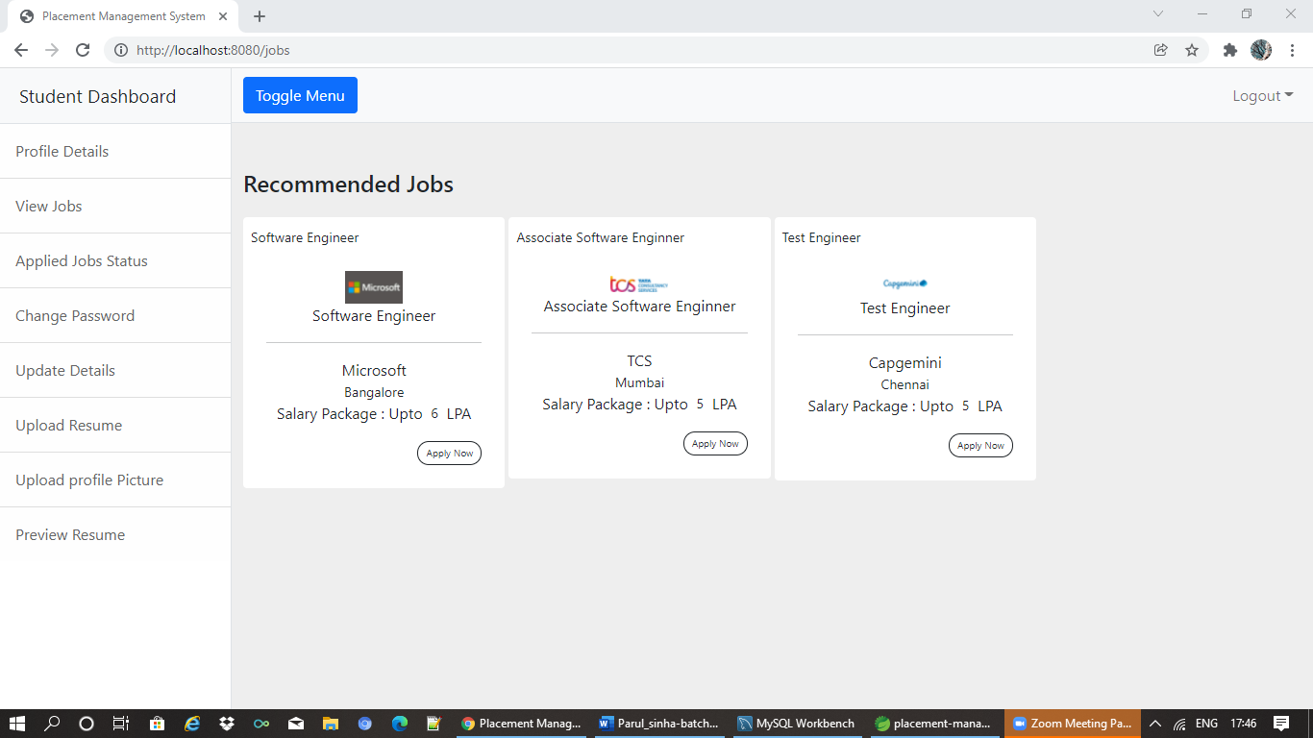
STUDENT JOB DASHBOARD PAGE

Slide 18
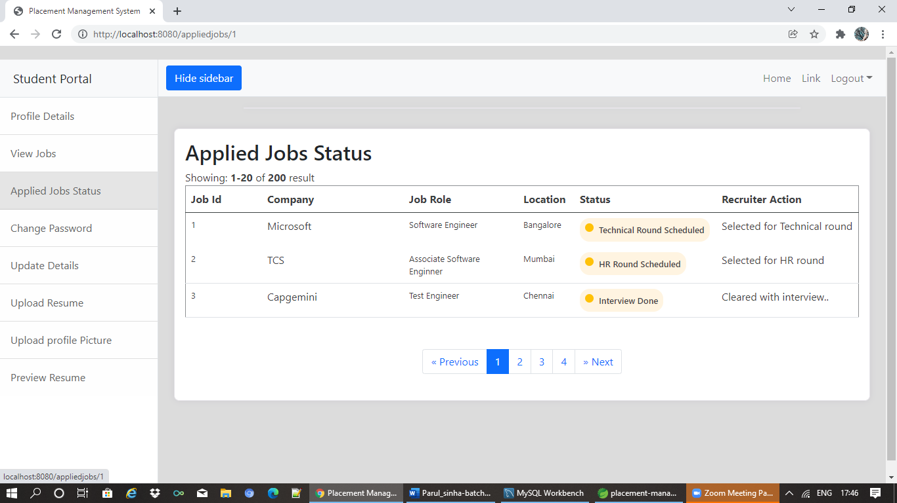
JOB APPLIED STATUS PAGE

Slide 19
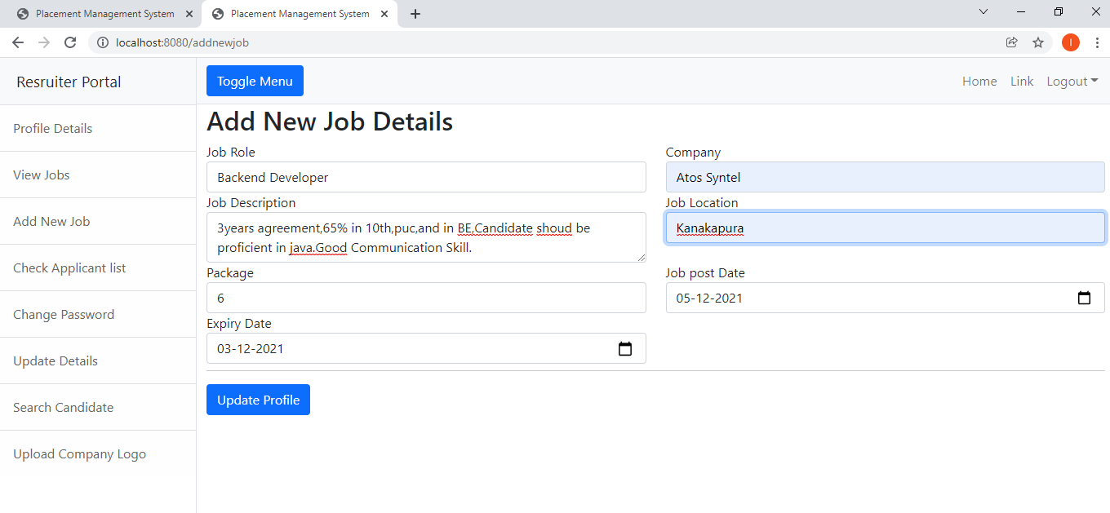
ADD NEW JOB PAGE

Slide 20
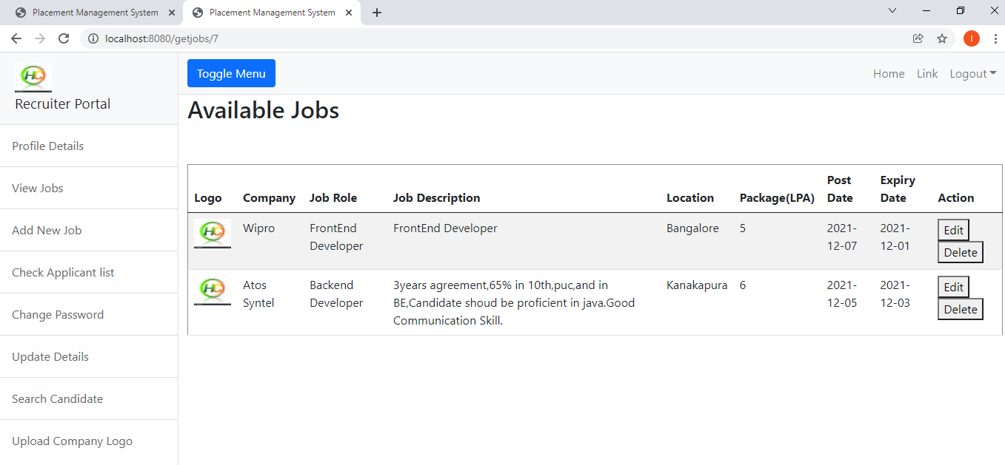
VIEW JOB PAGE

Slide 21
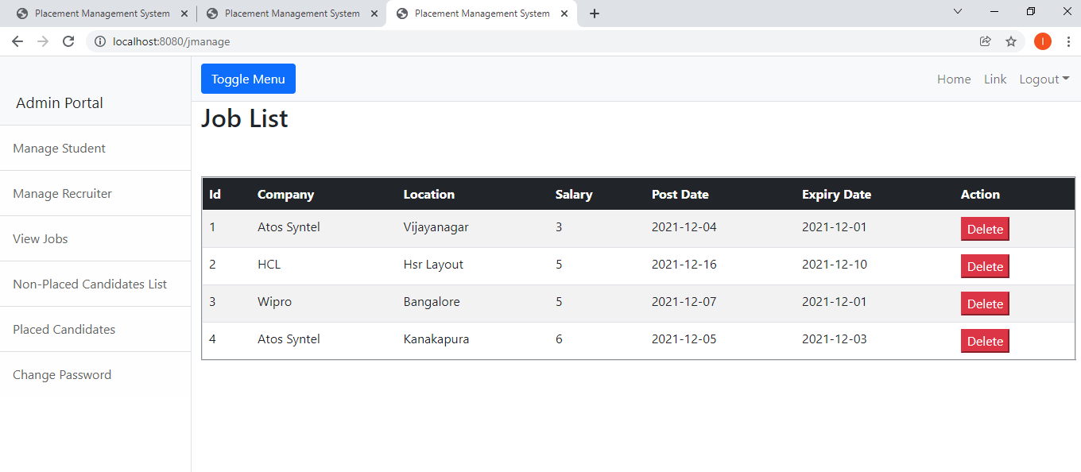
ADMIN JOB LIST PORTAL

Slide 22
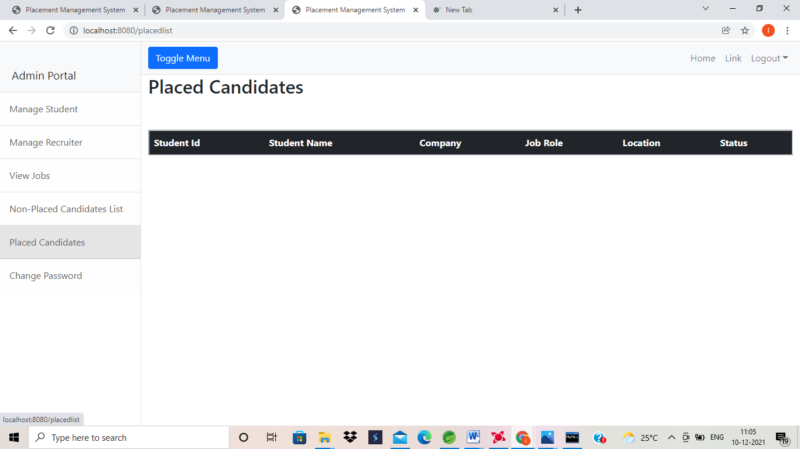
PLACE CANDIDATES LIST

Slide 23
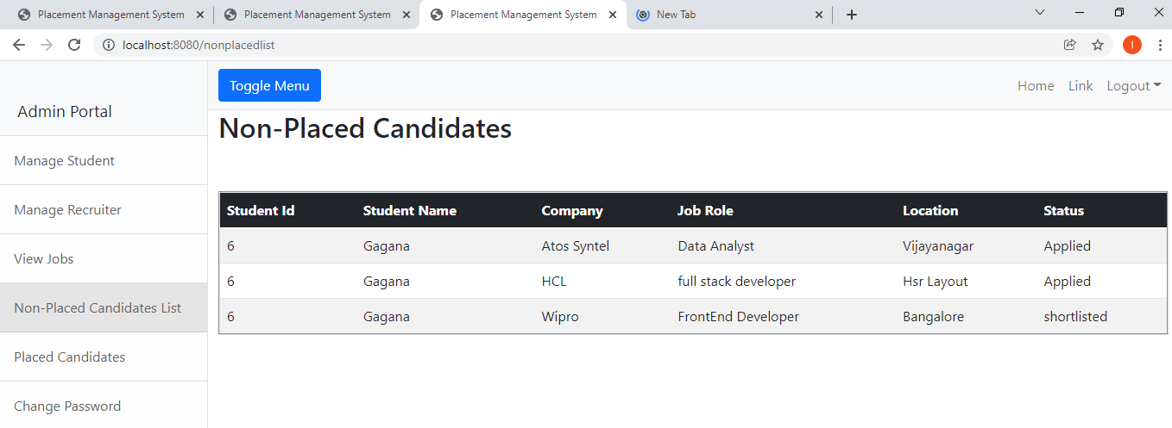
NON-PLACED CANDIDATES LIST

Slide 24
THANK YOU

